Slide 1

Group Project 2021
Team 14
Penetration Testing Scenario

Slide 2
Team Roles
Kenneth Brown: Project Manager
Davide Pisanu: PM Support & Server Administrator
Connor Grattan: Web Team Lead & Back-End Developer
Jake Salt: Web Team & Front-End Developer
Tom Neil: Security Team Lead
Luis Loaysa: Security Team

Slide 3
Critical Aims
Create a Virtual Machine test-bed
Optimised to accommodate security penetration testing
Create a vulnerable E-Commerce website within the test-bed network
To be used for carrying out web-based attacks, such as Cross-Site Scripting
Modern OS versions and hardware only
To maintain a realistic scenario & improve on outdated labs

Slide 4
Additional Aims
Create challenging scenarios for students
Create scenarios & labs which provide students with opportunities for self-directed learning
Create a logical exploit path using privilege escalation techniques
Opportunity for the whole team to further own knowledge & improve skillsets with Cybersecurity & Secure Web-Development

Slide 5

Technical Approach - Server
Proxmox -VM Platform
Open-source server management platform
Integrates KVM, LXC, and QEMU virtualisation
Enterprise-class features
Efficient Virtual Environment

Slide 6
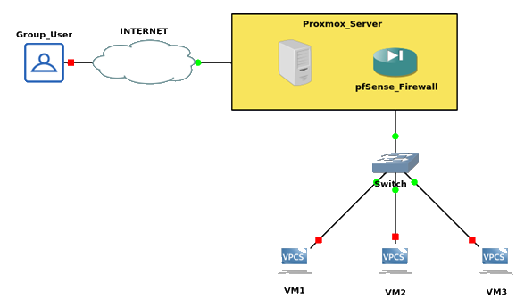
VPN Setup
OpenVPN
Trusted Security
Adaptable
Open Source
Supports multiple encryption standards

Slide 7
VPN Setup
pfSense
Simple but effective design
Open source FreeBSD
Implementation
OpenVPN Server
Certificate Authority

Slide 8
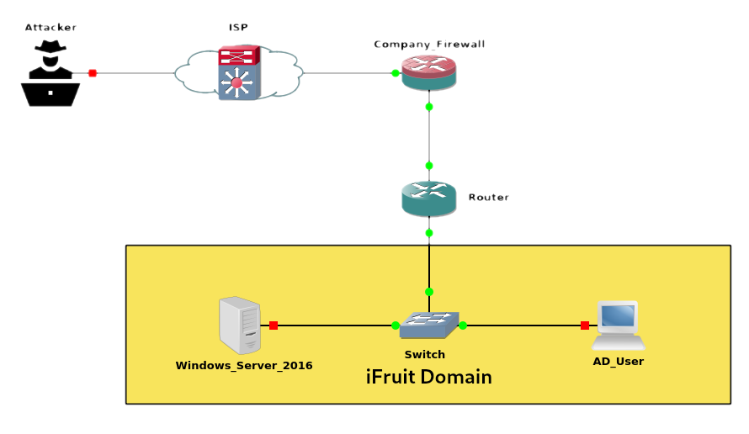
Network Topology
Operating Systems deployed: -
Windows Server 2016 (Web Server/AD)
Windows 10-1809 (AD User)
Kali Linux (Attacker)
Vulnerabilities: -
Unpatched versions of Windows’ OS
Weak Firewall Rules
Hosted Website specifically configured for exploits

Slide 9
Technical Approach – E-Commerce site

Slide 10
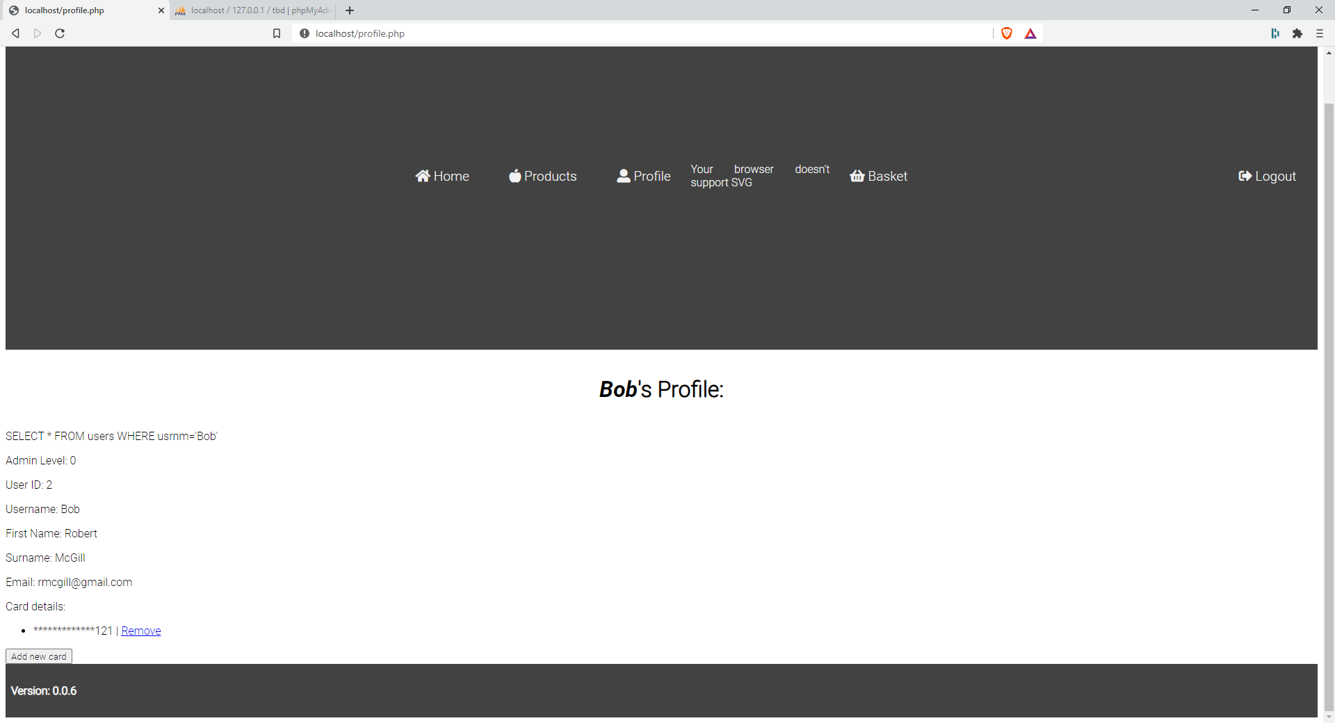
Website –User Profile Page

Slide 11
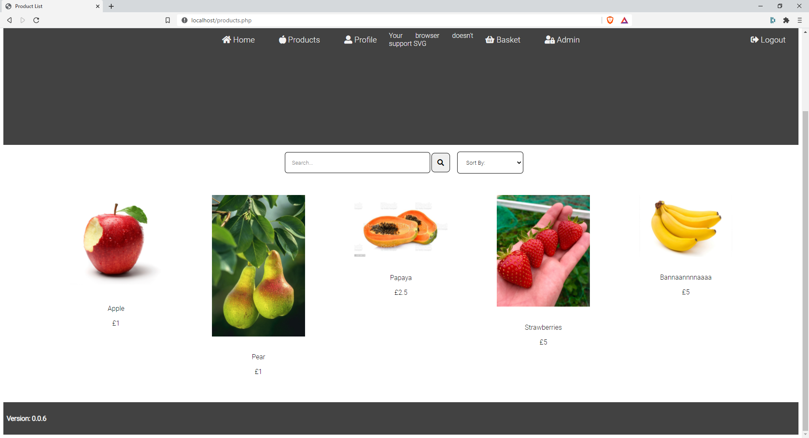
Website –Products Page

Slide 12
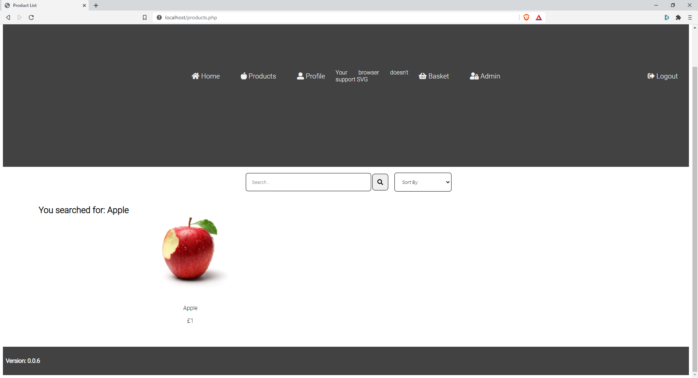
Website –Search Bar Feature

Slide 13
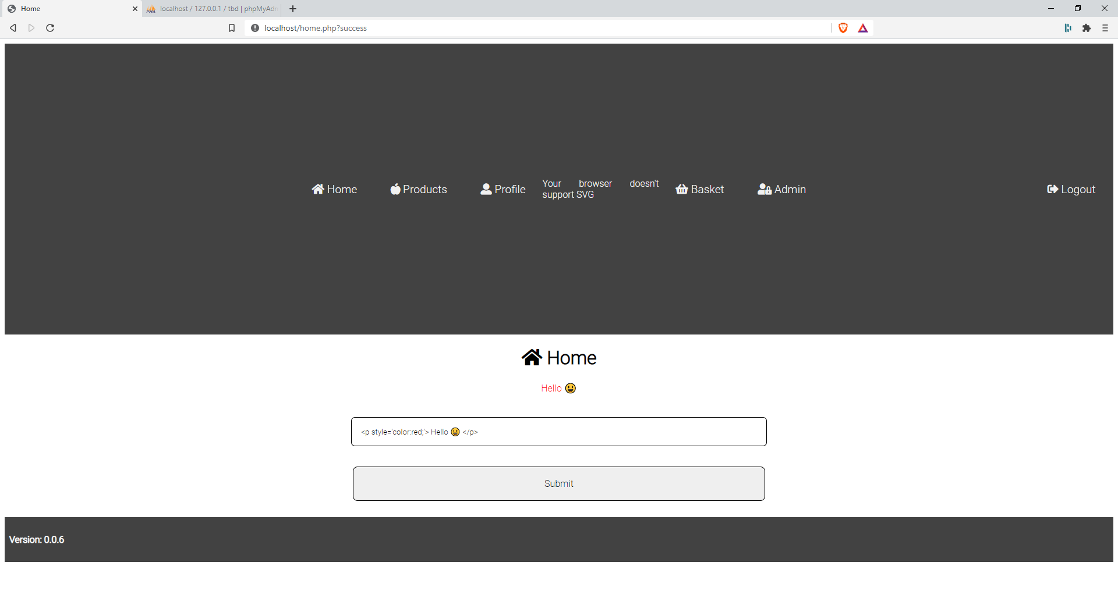
Website –Index Page

Slide 14
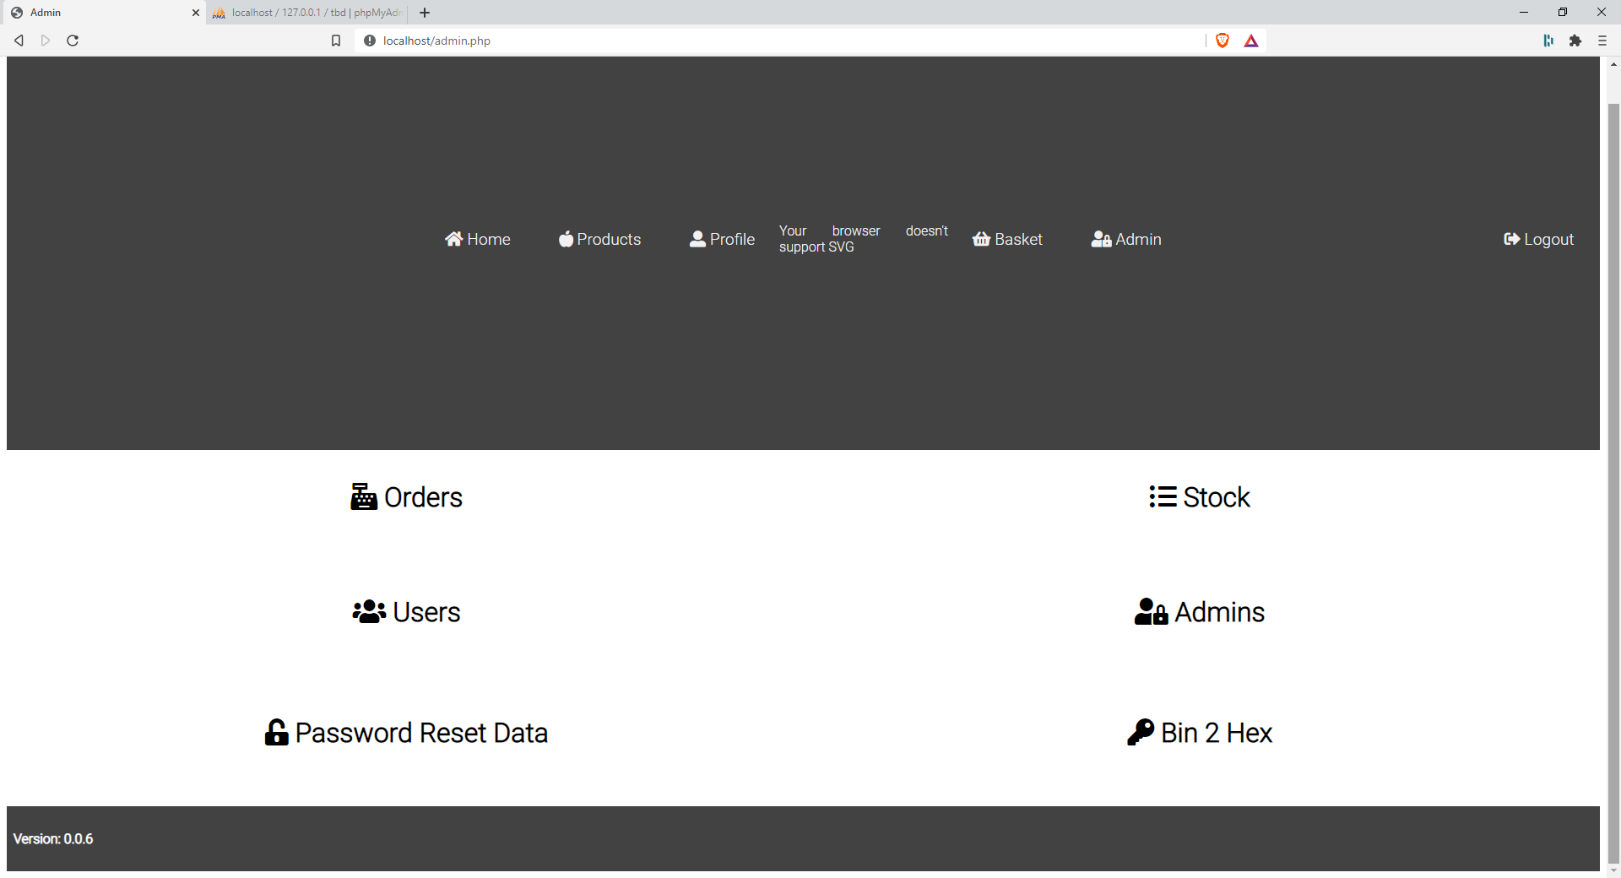
Website –Admin User Page

Slide 15



Website –Back-End Specs
XAMPP
Apache web server
MySQL database: -
Users can store admins and also hashed passwords
Products
Card details act as a ‘flag’ to be found by students
Orders

Slide 16

Website –Vulnerabilities
Un-sanitized Search bar for Cross-Site Scripting.
Password Reset exploit to gather or modify specific accounts’ details.
Absence of a specific server header allows for Clickjacking & Brute-Force attacks.
Potential for Bot-Net Deployments
PSEXEC Exploit allow for mail-server attacks.

Slide 17


Cross Site Scripting - Setup
Cross-Site Scripting (XXS) vulnerability on the website
Kali Linux VM: – Attacker
Burpsuite: - Mapping & Analysis of the website’s attack surface
FoxyProxy: – Configured to allow for routing of traffic

Slide 18
Cross-Site Scripting - Process
Products page containing search bar
XSS exploits could be tested
GitHub repository with common scripts used for testing

Slide 19
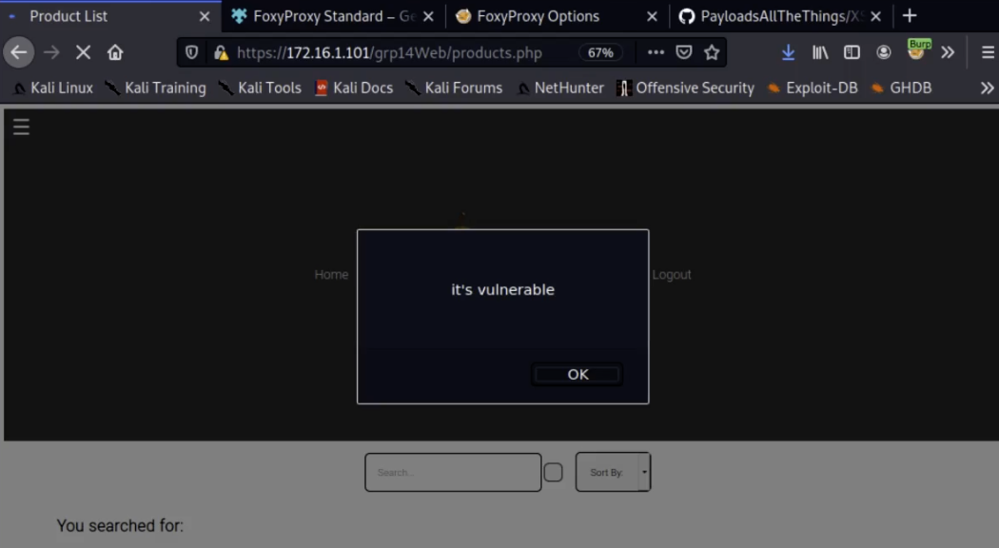
Cross-Site Scripting - Process
JavaScript Alert Function
Confirms products page is vulnerable to XSS attacks

Slide 20
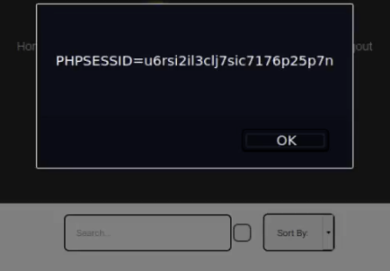
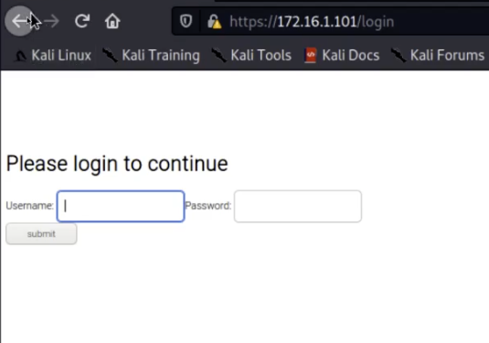
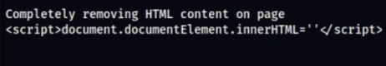
Cross-Site Scripting - Results
Further scripts implemented – user document cookies
UI redressing modifying HTML content
Removing HTML content displayed on the Products page
Notes:
Hand over to Luis covering Clickjacking

Slide 21
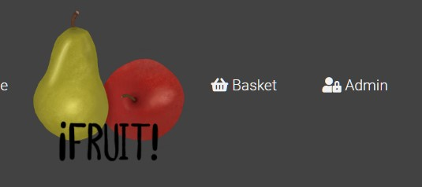
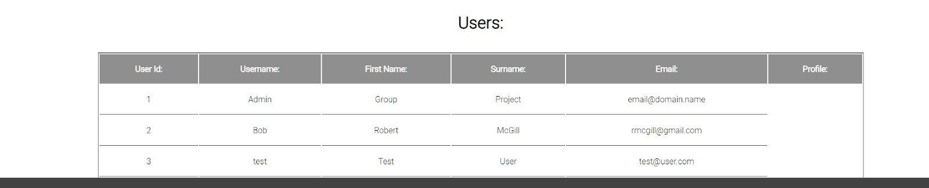
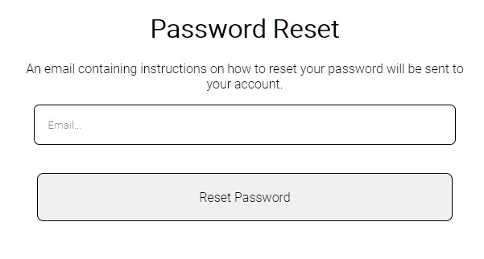
Password Reset Exploit - Setup
Gain access to Web Admins account through other privilege escalation techniques.
Use website admin features to gain access to user E-mails.
Initiate the password reset process for the targeted website user.

Slide 22
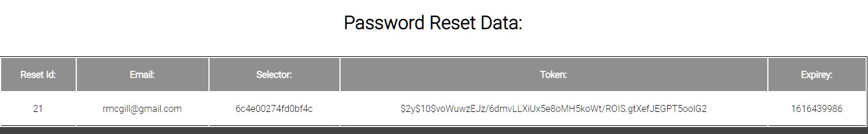
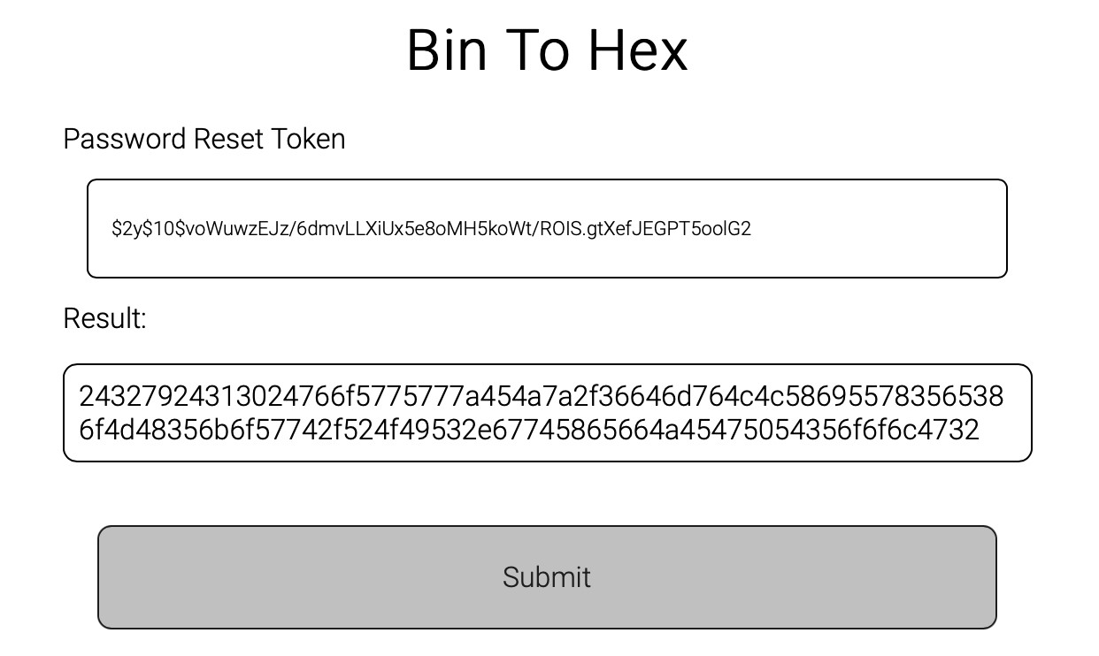
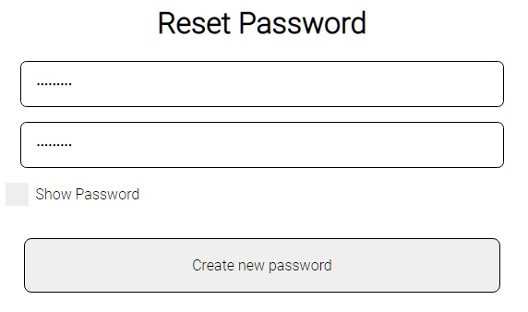
Password Reset Exploit - Results
Retrieve Validators & Selector tokens from Admins password reset entries.
Convert token using websites ‘bin 2 hex’ Admin feature.
Input selector and hex token into the URL and redirect to the target users password reset page.
Change password and login to target users account to access account details.

Slide 23
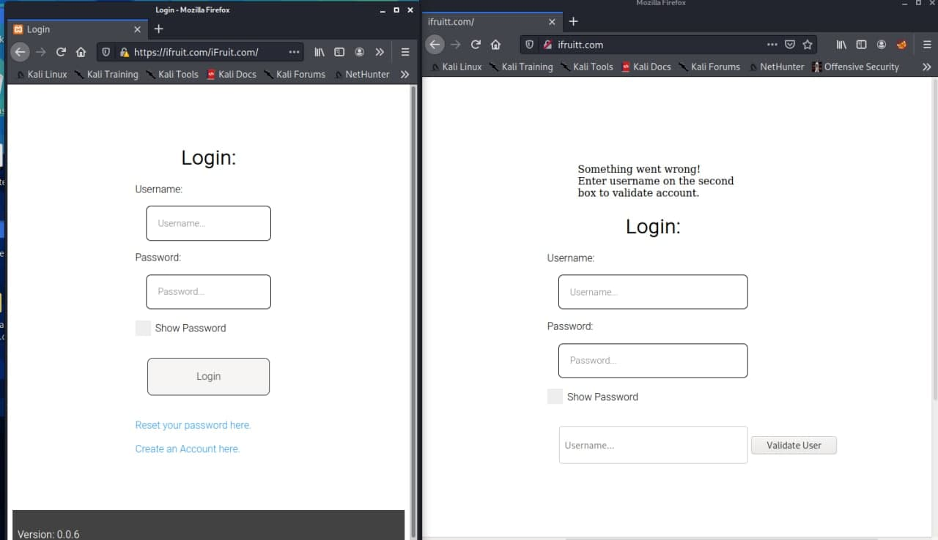
Clickjacking Attack
Aim: - Retrieve usernames through a forged website using a similar address to the original site. (i.e. www.ifruitt.com)
Requirements: - HTML, CSS, Apache2, PHP
Student Lab Approach: - The student is expected to retrieve user input from a target host that has been deceived by the fake address.
Real Site Fake Site

Slide 24
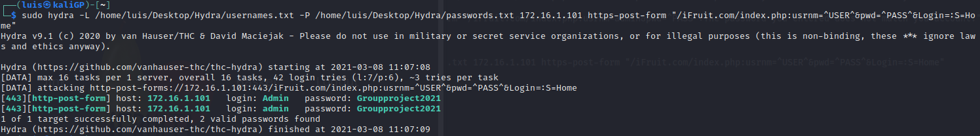
Brute Force Attack
Aim: - Extract usernames from Clickjack and then test password combinations in Hydra for matches.
Requirements: - Hydra and error messages from the victim’s website.
Student Lab Approach: - Use Hydra to gain access to the user passwords through a brute-force attack.

Slide 25
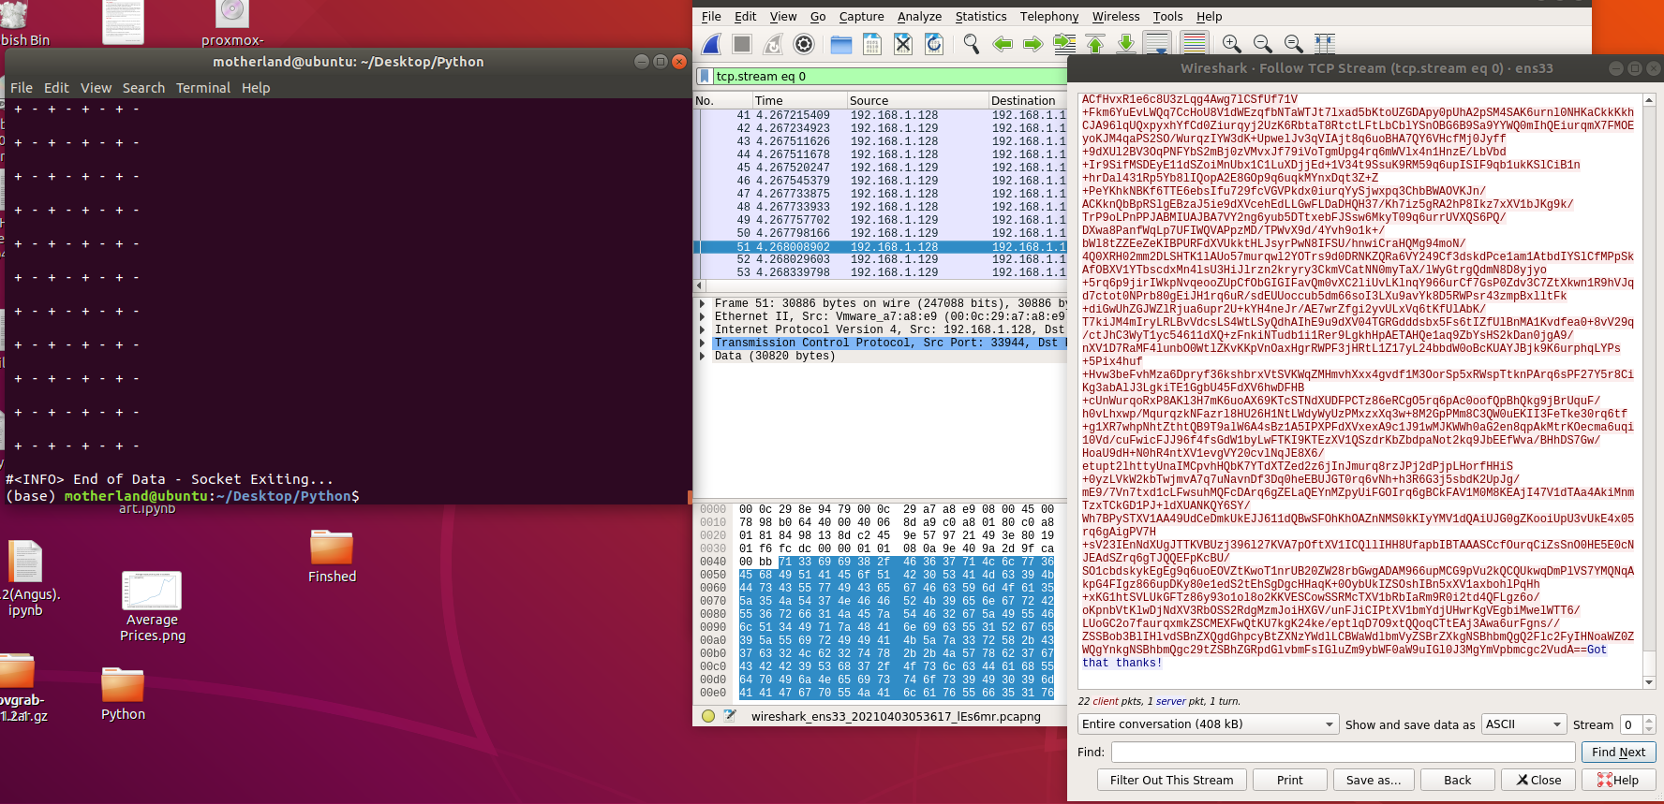
Python Bot Attack
Aim: - Open communication from a remote machine without user knowledge.
Requirements: - Python, Stenography, Ciphers, Wireshark, concealment strategies.
Student Lab Approach: - Study the bot and upload it to the E-commerce platform for victims to download.

Slide 26
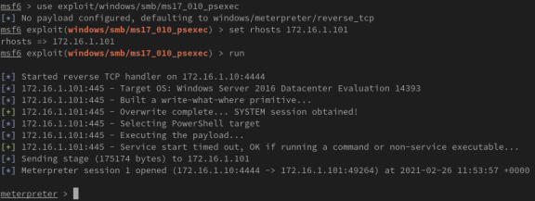
Reverse TCP Exploit
FILEFORMAT Exploit Deployment: -
Create files for trigger Vulnerabilities
Move MVK files on Kali /html dir
Send malicious mail to the AD users
Start a reverse TCP session
Gain Access to AD user

Slide 27
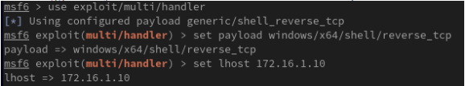
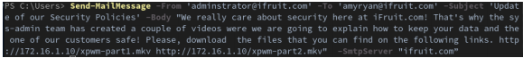
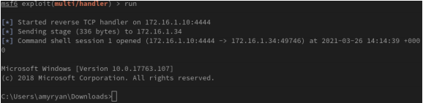
Reverse TCP Exploits
Steps Involved: -
Access to targeted machine with High privileges User (system)
Create a New Administrator User
Craft mail and forward to all the AD users
Start to listen to the LAN Traffic
Gain Access to AD User

Slide 28
Technical Limitations
Remote working / COVID 19 restrictions
ISP Cut Offs
Scope / Time limitations
E-commerce payment system

Slide 29

Future Roadmap
Complete the remaining WIP exploits
Continue adding further pen-test functionality to the website & server.
Develop new exploit scenarios for the environment.
Improve the realism of our environment by adding further layers of security.

Slide 30
Any Questions?
If anyone has any questions about our project, feel free to ask them now!

